Slide 1
In each of the following pictures you will identify the tone by either checking the box or generating your own word that best captures the person’s feelings/opinion regarding his/her situation or environment.
TONE

Slide 2
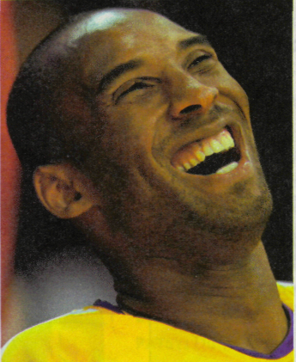
Tone: How does this basketball player seem to feel after a game?
Romantic
Annoyed
Ecstatic
Modest
Athletics

Slide 3
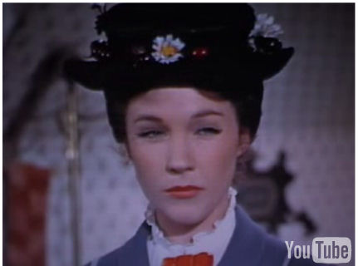
Tone: How does this nanny seem to feel toward her new charges?
Motherly
Stressed
Suspicious
Calm
Mary Poppins

Slide 4
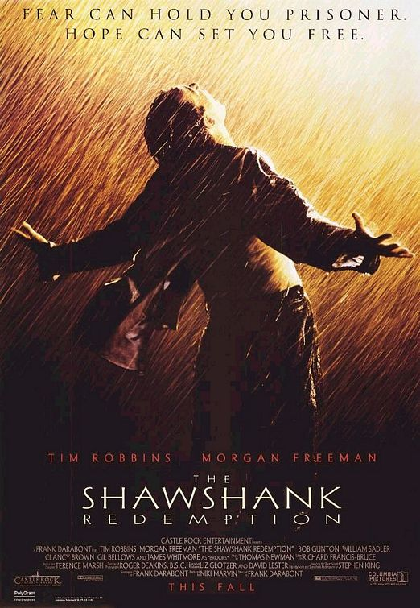
Tone: What is this prisoner’s attitude about his recent escape?
Disrespectful
Bitter
Released
Cynical (pessimistic)
The Shawhank Redemption

Slide 5
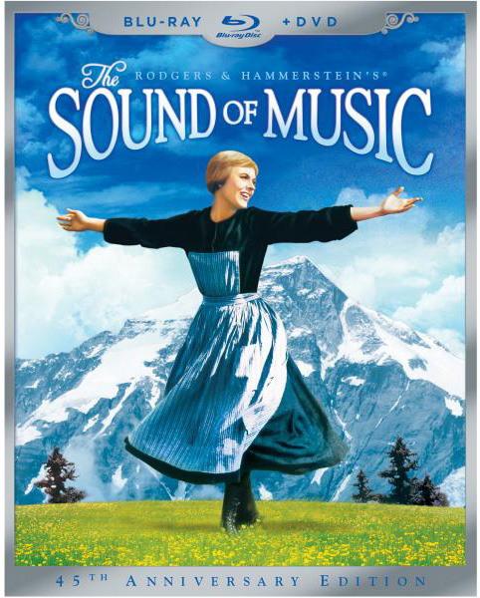
Tone: What feeling/attitude does the young woman have towards her experience wandering in the mountains?
Silly
Passive (submissive)
Carefree
Detached (disconnected)
The Sound of Music

Slide 6
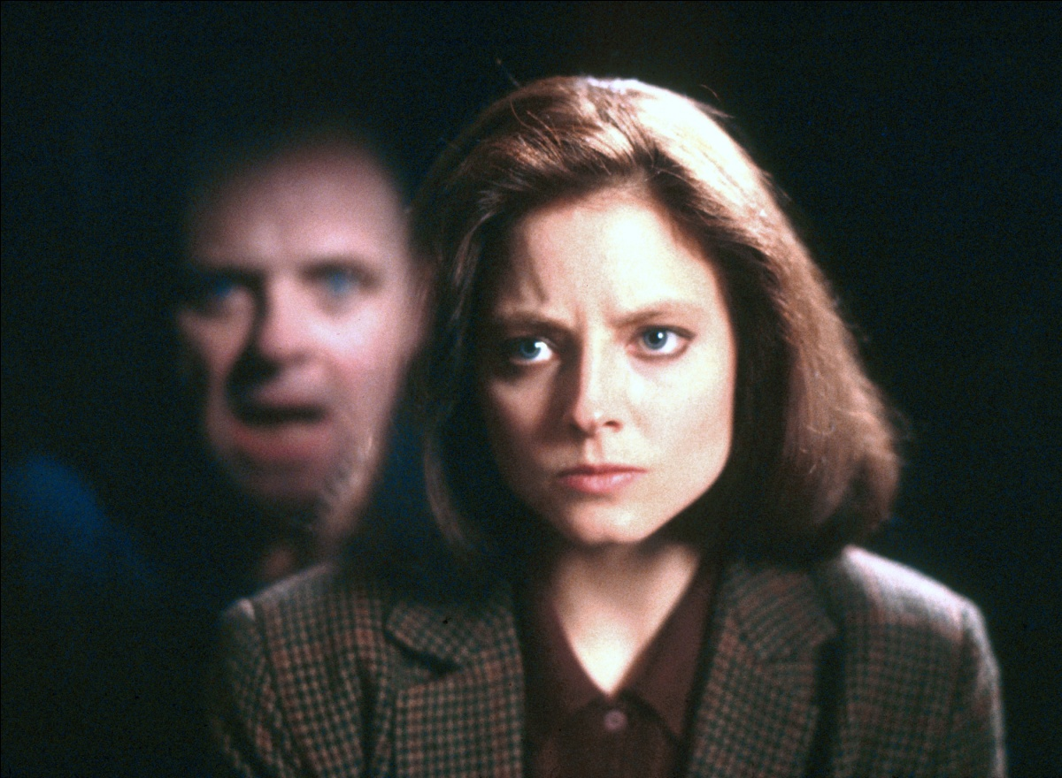
Tone: What is the female FBI agent’s attitude toward her meeting with a convicted cannibal?
Nostalgic (longing for the past)
Suspicious
Regretful
Embarrassed
The Silence of the Lambs

Slide 7
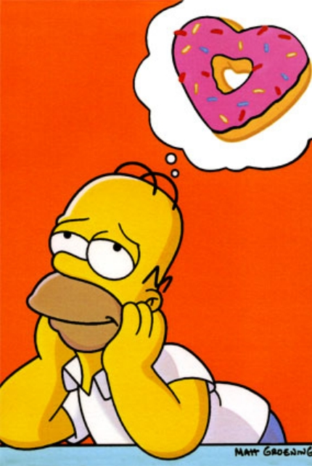
Tone: How does Homer feel about the doughnut?
Disdainful (scornful)
Pining (longing, desiring)
Comical
Ridiculing
The Simpsons

Slide 8
Tone: How does this boss regard her position as editor-in-chief of a magazine?
Disgruntled
Whimsical (fanciful)
Threatened
Confident
The Devil Wears Prada

Slide 9
Tone: What is this ballerina’s attitude toward her performance?
Reflective and unsure
Proud and arrogant
Bitter and mocking
Amused and appreciative
Black Swan

Slide 10
Tone: What is attitude of the girls regarding their school and the people in it?
Incredulous (disbelieving)
Sympathetic
Matter-of-fact
Urgent
Mean Girls

Slide 11
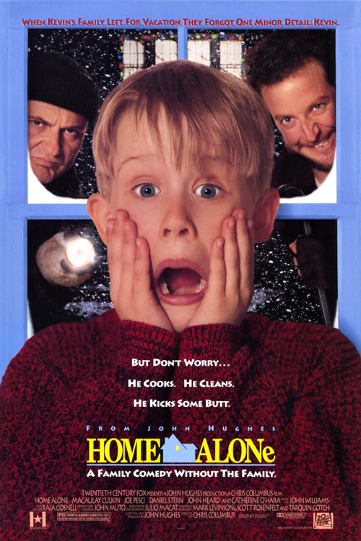
Tone: What is this boy’s attitude about being left home alone?
Your word:
_________________
Home Alone

Slide 12
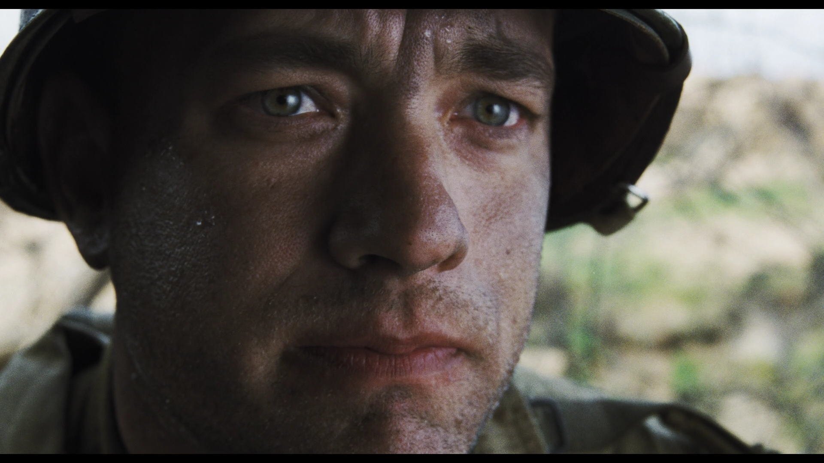
Tone: What is the soldier’s opinion about fighting in a war?
Your word:
_________________
Saving Private Ryan

Slide 13
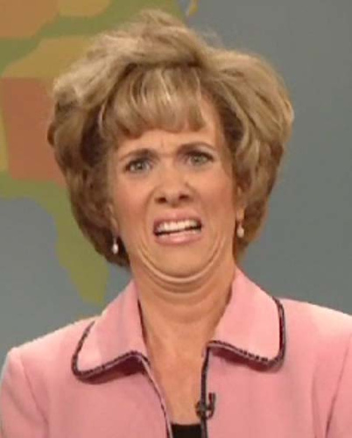
Tone: What is the comedian’s opinion toward the topic of conversation?
Your word:
_________________
Saturday Night Live

Slide 14
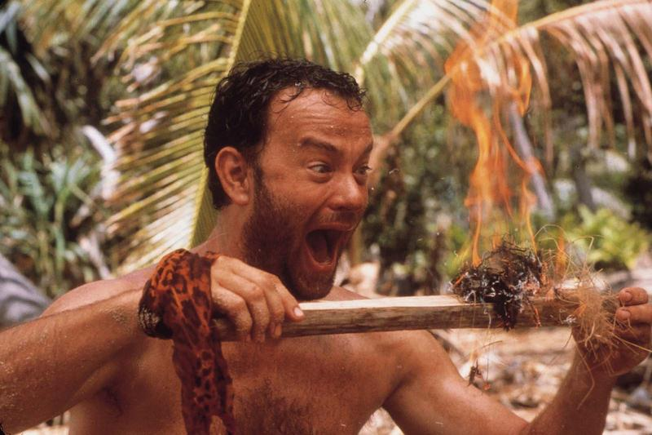
Tone: What is the castaway’s opinion regarding his ability to produce fire?
Your word:
_________________
Cast Away

Slide 15
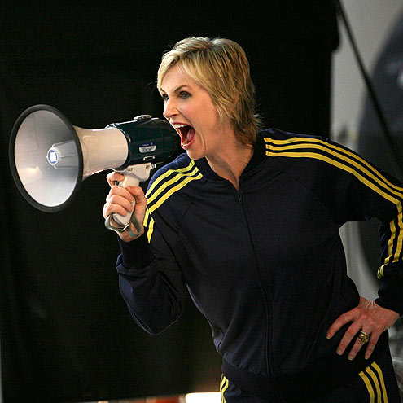
Tone: How does the coach seem to feel toward her athletes?
Your word:
_________________
Glee

